Slide 1
Liang Wenfeng: Pioneering Success in Entrepreneurship and Artificial Intelligence
Exploring the Journey of DeepSeek's Visionary Founder​

Slide 2
The best way to predict the future is to create it.
How DeepSeek’s Founder Disrupted the AI Industry with Vision & Strategy

Slide 3
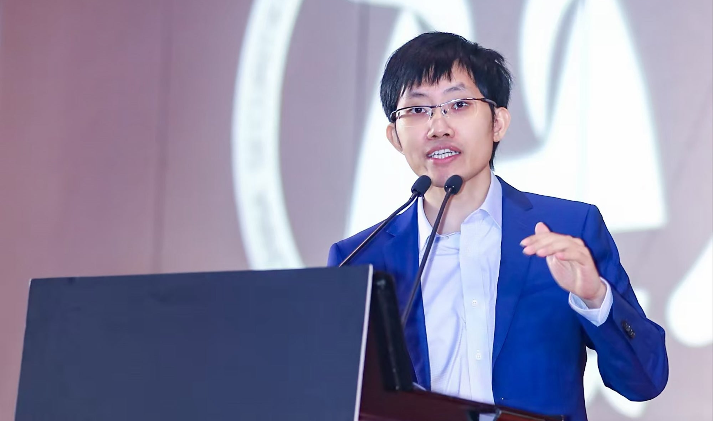
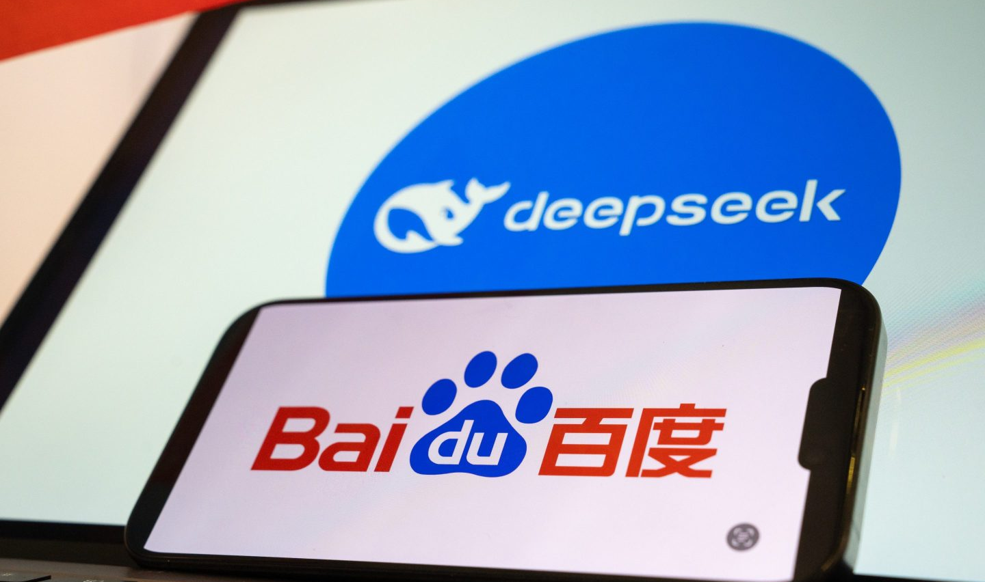

Early Life and Education
Background
Education
University
Born in 1985 in Zhanjiang, Guangdong, China, to a family of educators.
Excelled academically, leading to top scores in the Gaokao examination.​
Attended Zhejiang University, earning both bachelor's and master's degrees in electronic information engineering.

Slide 4
First Steps into Entrepreneurship
Founded High-Flyer Quantitative Hedge Fund (2015)
Used AI-powered stock trading
Managed over 100 billion yuan ($14 billion USD) in assets
Revolutionized algorithmic trading in China
Key Lesson for Entrepreneurs:
Identify gaps in the market – AI in finance was an emerging field.
Leverage technology – Used AI to outperform traditional trading methods.

Slide 5
Strategic Vision and Foresight
Anticipating AI's Rise: In 2021, began acquiring NVIDIA GPUs, foreseeing their critical role in future AI developments.​ (Encyclopaedia Britannica)
Navigating Challenges: This strategic move mitigated the impact of subsequent U.S. export restrictions on advanced AI chips to China. (​Encyclopaedia Britannica, aidigitalx.com)

Slide 6
First Steps into Entrepreneurship
In 2021, started purchasing NVIDIA GPUs in bulk
Why? He predicted that AI computing power would soon face restrictions
Outcome: When the US banned chip exports to China, DeepSeek was unaffected
Entrepreneurial Takeaway:
Think ahead of the curve – Make moves before others realize the opportunity.
Prepare for obstacles – Successful businesses anticipate crises and solve problems before they arise.

Slide 7
Founding of DeepSeek
In 2023, founded DeepSeek with a modest capital of $1.4 million, focusing on artificial general intelligence.​ (aidigitalx.com, Encyclopaedia Britannica)

Slide 8
Founding DeepSeek – Creating a New AI Giant
Founded in 2023 with just $1.4 million capital
Mission: To develop artificial general intelligence (AGI) at a lower cost
First Big Release – DeepSeek-V2 (2024)
Cheaper than OpenAI’s ChatGPT & Google Gemini
Faster and more efficient than other Chinese AI models
Disrupted the market → Started an AI price war in China
Lesson: Disruptive innovation can help small startups compete with giants.

Slide 9
Breakthroughs and Market Impact
DeepSeek’s AI Model Success
Jan 2025: #1 on U.S. iOS App Store
Surpassed ChatGPT in free user downloads
Became China’s leading AI model competing with OpenAI & Google
What Made DeepSeek Stand Out?
Cost-Effective AI – Offered high-quality AI at a lower price
Technological Efficiency – Focused on optimized algorithms for speed
Global Expansion Strategy – Reached international markets quickly

Slide 10
Leadership & Company Culture at DeepSeek
Hired Based on Talent, Not Experience
Recruited engineers with raw skills rather than those with years of experience
Encouraged Fast Iteration & Learning
Employees were encouraged to take risks and fail fast, learn fast
Maintained Work-Life Balance (Unlike China's 996 Culture)
Allowed flexibility, leading to higher creativity & productivity
Key Lesson:
A great entrepreneur builds a great team.

Slide 11
Leadership and Organizational Culture
National Hero: Celebrated for his contributions to AI technology, symbolizing the realization of the "China Dream.“ (​The Times)
Government Recognition: Participated in high-level symposiums with Chinese leadership, highlighting his role in advancing national tech competitiveness. ​(The Times, Encyclopaedia Britannica)

Slide 12
Lessons in Successful Entrepreneurship
Visionary Thinking: Identified and acted upon emerging technological trends ahead of the curve.​
Resilience: Overcame geopolitical challenges through strategic planning and resourcefulness.​
Innovation: Consistently pushed the boundaries of AI development, setting new industry standards.​
Leadership: Cultivated a company culture that values talent, creativity, and employee well-being.

Slide 13
Challenges & Overcoming Barriers
Geopolitical Challenges
U.S. chip bans & AI regulations threatened DeepSeek’s growth
Solution: Pre-bought NVIDIA GPUs and developed AI chips locally
Competing with Giants (OpenAI, Google, Baidu)
Solution: Focused on efficiency, affordability, and faster execution
Scaling AI Training Costs
Solution: Used innovative optimization methods to train AI models faster & cheaper
Lesson for Entrepreneurs:
“Every big idea faces roadblocks. The winners are those who find solutions before others even realize the problem.”

Slide 14
Key Takeaways for Entrepreneurs
“Success in entrepreneurship is about making the right bets at the right time.” – Liang Wenfeng

Slide 15
Key Takeaways for Entrepreneurs
Timing Matters – Invest in emerging trends early.
Be Resourceful – Overcome challenges with smart planning.
Focus on Innovation – Always be one step ahead of competitors.
Build a Strong Team – Hire smart people and let them innovate.
Think Globally – Don’t limit your market to one region.
Note: This presentation is based on information available up to March 17, 2025.

